Slide 1
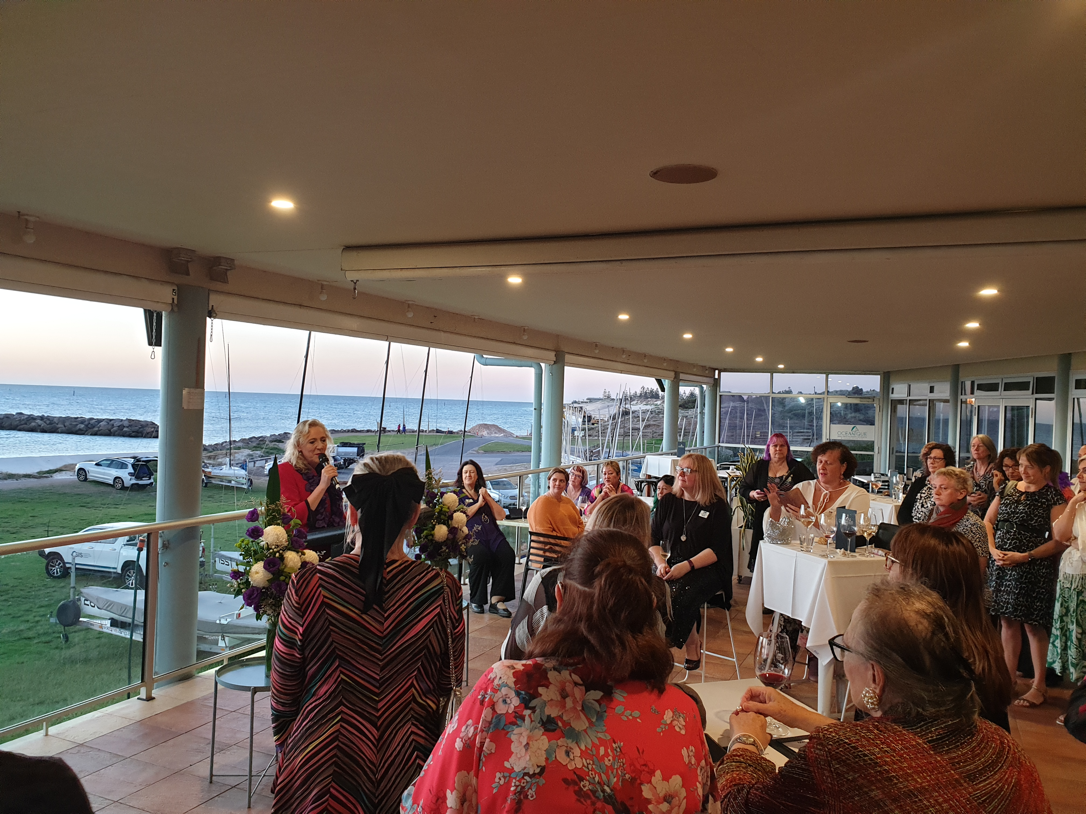
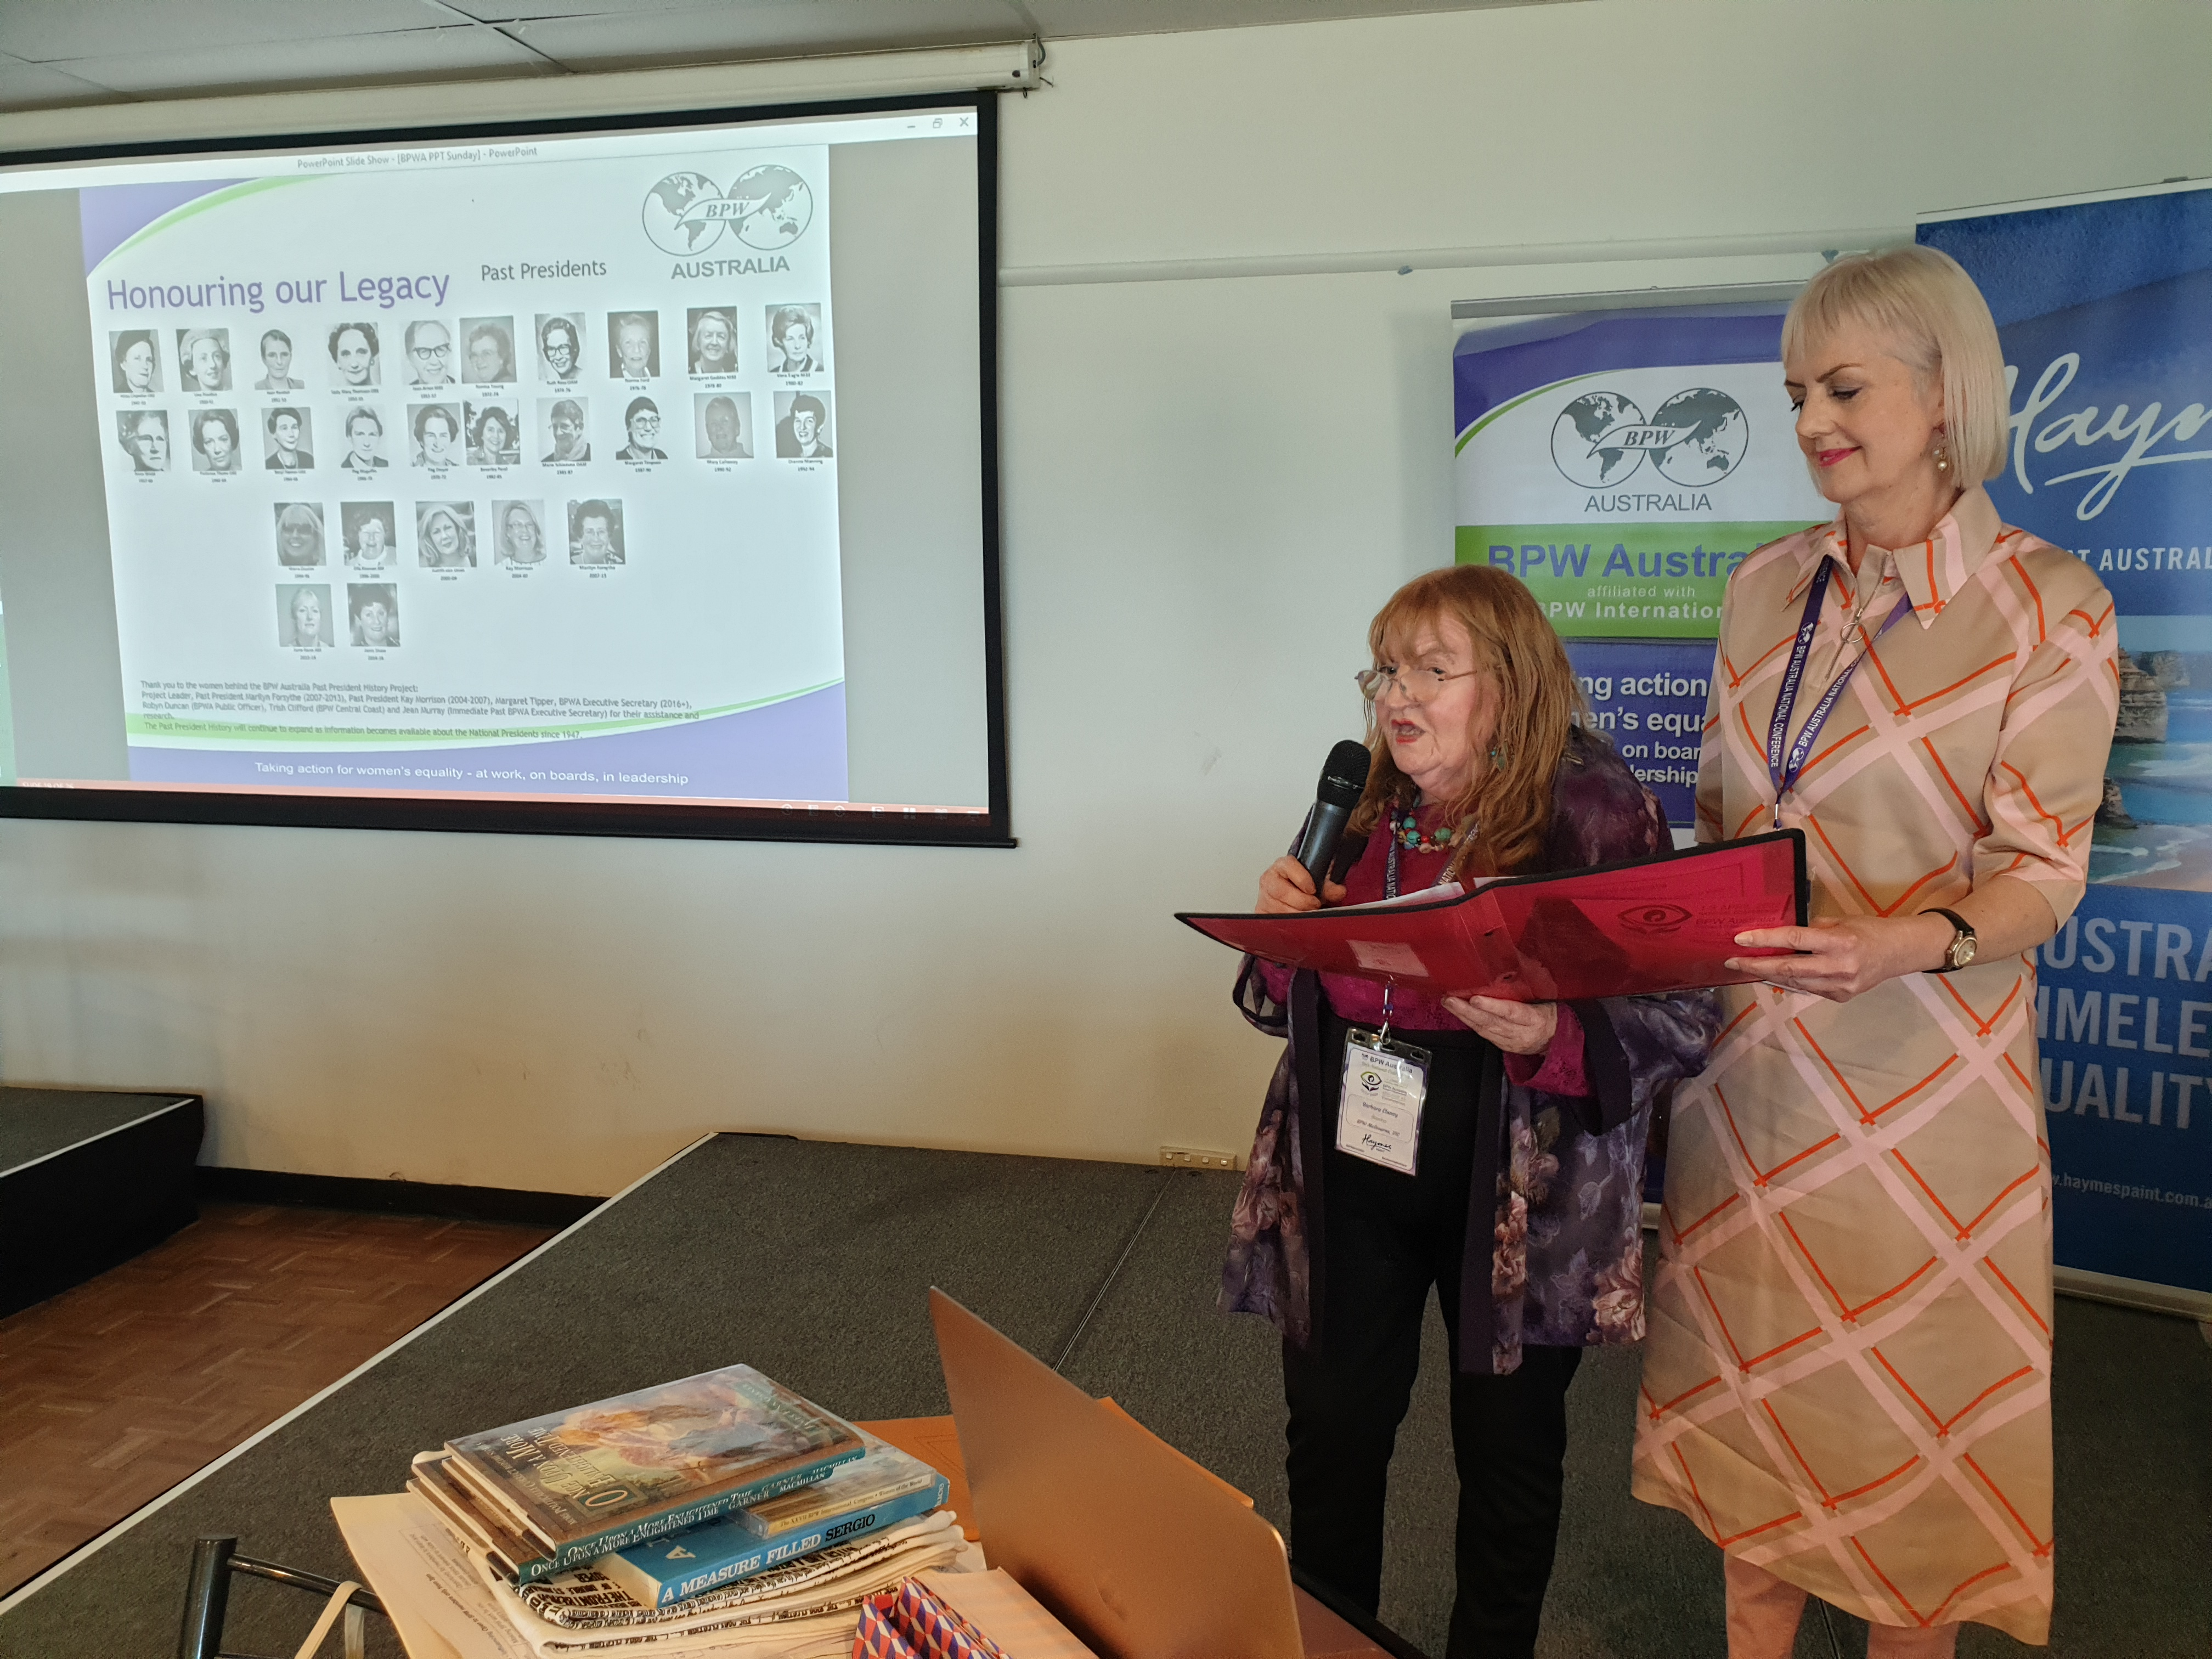
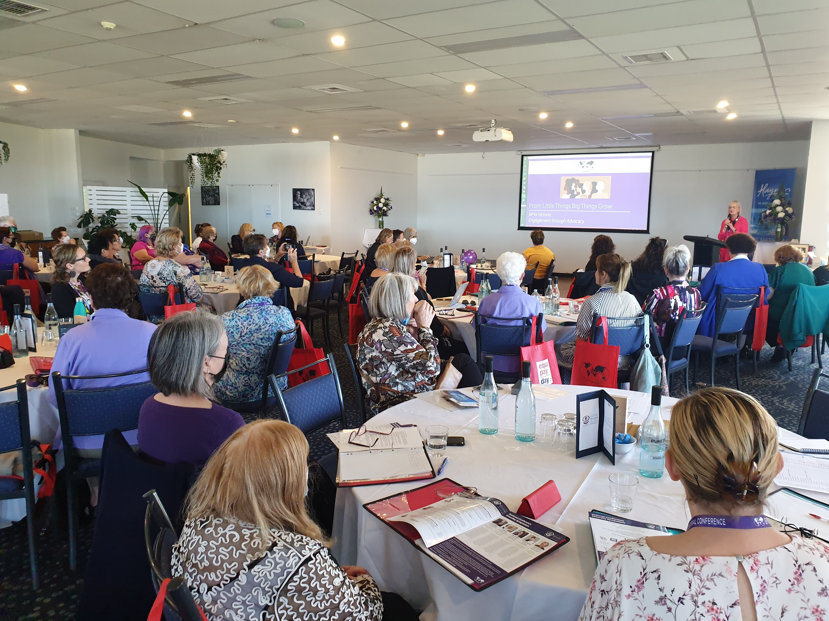
From Little Things Big Things Grow
BPW Victoria Engagement through Advocacy

Slide 2
Contributing to legislative change that advances Gender Equality in Victoria
Building relationships through policy engagement, with:
Government
Government Agencies; and
Between BPW Clubs
Notes:
Acknowledgement of the expertise and experience of BPW Adelaide in policy engagement over many years – compared to their high benchmark, we started with virtually nothing. Coming off a low base.
And also acknowledgment of the personal commitment and passion of our National President, Jacqueline Graham, in encouraging Victorian Clubs to get on board with the process I am about to describe. And her work in personally building on the momentum created by our initial foray into the space, as well as building relationships with Government Ministers and key players, to position us as a potential trusted partner.
Invite her input as the presentation proceeds.

Slide 3
Victoria’s Gender Equality Strategy
“If we are serious about ending violence against women, then we must begin by addressing gender inequality. After all, bad outcomes for women begin with bad attitudes towards women.
But gender inequality isn't just happening in our homes. It's happening in our workplaces, in our school yards, on our television screens and on our sporting fields.
Gender inequality means Victoria is losing out. By limiting the potential of women, gender inequality acts as a drain on the Victorian economy. We need to address the barriers that act as disincentives to the full participation of women in our economy and community.”
Development process led by The Hon Fiona Richardson MP, Minister for Women and Minister for the Prevention of Family Violence
Consultation Paper followed the Royal Commission into Family Violence in 2015
Notes:
And this is what the story of Victorian Government policy engagement is based on – it is about seizing an opportunity and running with it.
The Victorian Government announced it would develop a Gender Equality Strategy as a legacy of the Victorian Royal Commission into Family Violence which was completed in 2015 and made 227 recommendations to Government.
The Commission, and therefore the Government, made a direct link between Family Violence and Gender Inequality, because that inequality breeds negative attitudes toward women and undermines women’s empowerment.
And importantly, the Government drew a direct link between Gender Equality and Economic progress. The Workplace Gender Equality Agency recently confirmed that “more women in key decision making positions delivers better company performance, greater productivity and greater profitability”.
The same case can be made for the benefits that can accrue from having greater diversity across the economy.. Greater participation by women in the workforce reduces the welfare burden, enhances productivity and economic activity.
There is evidence to show that countries that maintain greater equality between men and women also experience a range of social benefits, including increased social cohesion, connectivity and greater health and wellbeing – all of which have positive economic impacts.

Slide 4
November 2015
First Contact
Call for Submissions in response to Consultation Paper
Momentum built within BPW Melbourne after Equal Pay Day Event in September
Victorian Club Roundtables held beginning in Melbourne, January 2016
Notes:
This is the context in which we had the call to action.
BPW saw the call for submissions just after our very successful Equal Pay Day event, focussing on the experiences of high profile women in the Law.
It was the first of a series of events that BPW Melbourne has convened – honing in on specific professions and examining the challenges and barriers to equality in not only pay, but opportunity for promotion and career progression.
Women in The Arts, Women in STEM, Women in Politics.
We thought – this is an opportunity to put forward some of the discussion points from our event. But where do we start?
The point was, we just had to put something in. Didn’t have to be a huge undertaking – we didn’t have to outline a position on all issues, just those that had been identified as important by our members and event participants.
Which then led to discussions with other Victorian Clubs, who in turn held their own meetings.

Slide 5
April 2016
Joint Submission
BPW Melbourne, on behalf of BPW Clubs in Victoria, made a formal submission to the Victorian Gender Equality Strategy
Notes:
And the result was a submission that we put forward on behalf of BPW Victoria. It was only 2 pages, and had a lot of bullet points.

Slide 6
BPW Victoria
Submission
Gender equality should be enshrined
in government:
Legislated targets
Grant criteria
Procurement contracts
Organisations to implement:
Transparent pay grading
Superannuation during carer’s leave
Recruitment pathways to board / senior executive roles
Flexible employment as the norm
UN Women’s Empowerment Principles
to be promoted across
government and the business
community
Focussed on:
Leadership
Equal pay
Superannuation
Balancing work and caring responsibilities
Notes:
Legislated targets on key indicators for gender equality, with regular reporting requirements.
Grant criteria to require applicants to demonstrate equal treatment of female and male recipients.
State procurement contracts to prescribe representation of women on boards and in leadership teams.
Competency based, transparent pay grading and regular audits of pay scales across organisations.
Structures to fund super payments during carers’ leave.
Improved transparency and corporate governance to ensure a more women are considered in recruitment to board and senior executive roles.
Employers to assess whether all positions can be flexible.
Promoting the UN Women’s Empowerment Principles across the Business Community

Slide 7
August 2016
Invitation from the Minister
Personal invitation to Jacqueline Graham as BPW State Representative
Sector based and regional consultation sessions
BPW Members attended sessions in Melbourne, Swan Hill, Geelong & Bendigo
Notes:
Jacqueline attended a couple of sessions.
Anne Daniel attended a session in Swan Hill on ………
I attended a session at the MCG looking at corporate issues, responsibilities and responses.
The Late Minister Richardson herself and senior staff attended. They were very serious. Facilitated sessions with whiteboards, butcher paper and lots of feedback from tables.

Slide 8
August / September 2016
Consultation feedback
Discussion Paper publicly releases feedback from consultations
Notes:
This is the flyer for another Consultation Session on Small Business, STEM and Innovation – that I think Jacqueline also attended?
I won’t go into lots of detail about the Discussion Paper as this was a long process….

Slide 9
December 2016
Safe & Strong: Gender Equality Strategy released
The Vision
All Victorians live in a safe and equal society, have access to equal power, resources and opportunities, and are treated with dignity, respect and fairness.
All Victorians recognise that gender equality is essential to economic prosperity and that gender inequality has significant economic cost.
Victoria leads the way in gender equality with sustained, enduring and measurable action.
The Strategy sets out:
Legislative changes
Reforms to employment practices, budgeting, policy, procurement and funding decisions
Areas of advocacy to the Commonwealth Government
Notes:
Again highlighting the economic benefits of enshrining gender equality.

Slide 10
Victoria’s Gender Equality Strategy
Acknowledges the importance of government leadership in addressing gender inequality and unconscious bias
Six Priority Action Areas
Education & Training
Work & Economic Security
Health, Safety & Wellbeing
Leadership & Representation
Sport & Recreation
Media, Arts & Culture

Slide 11
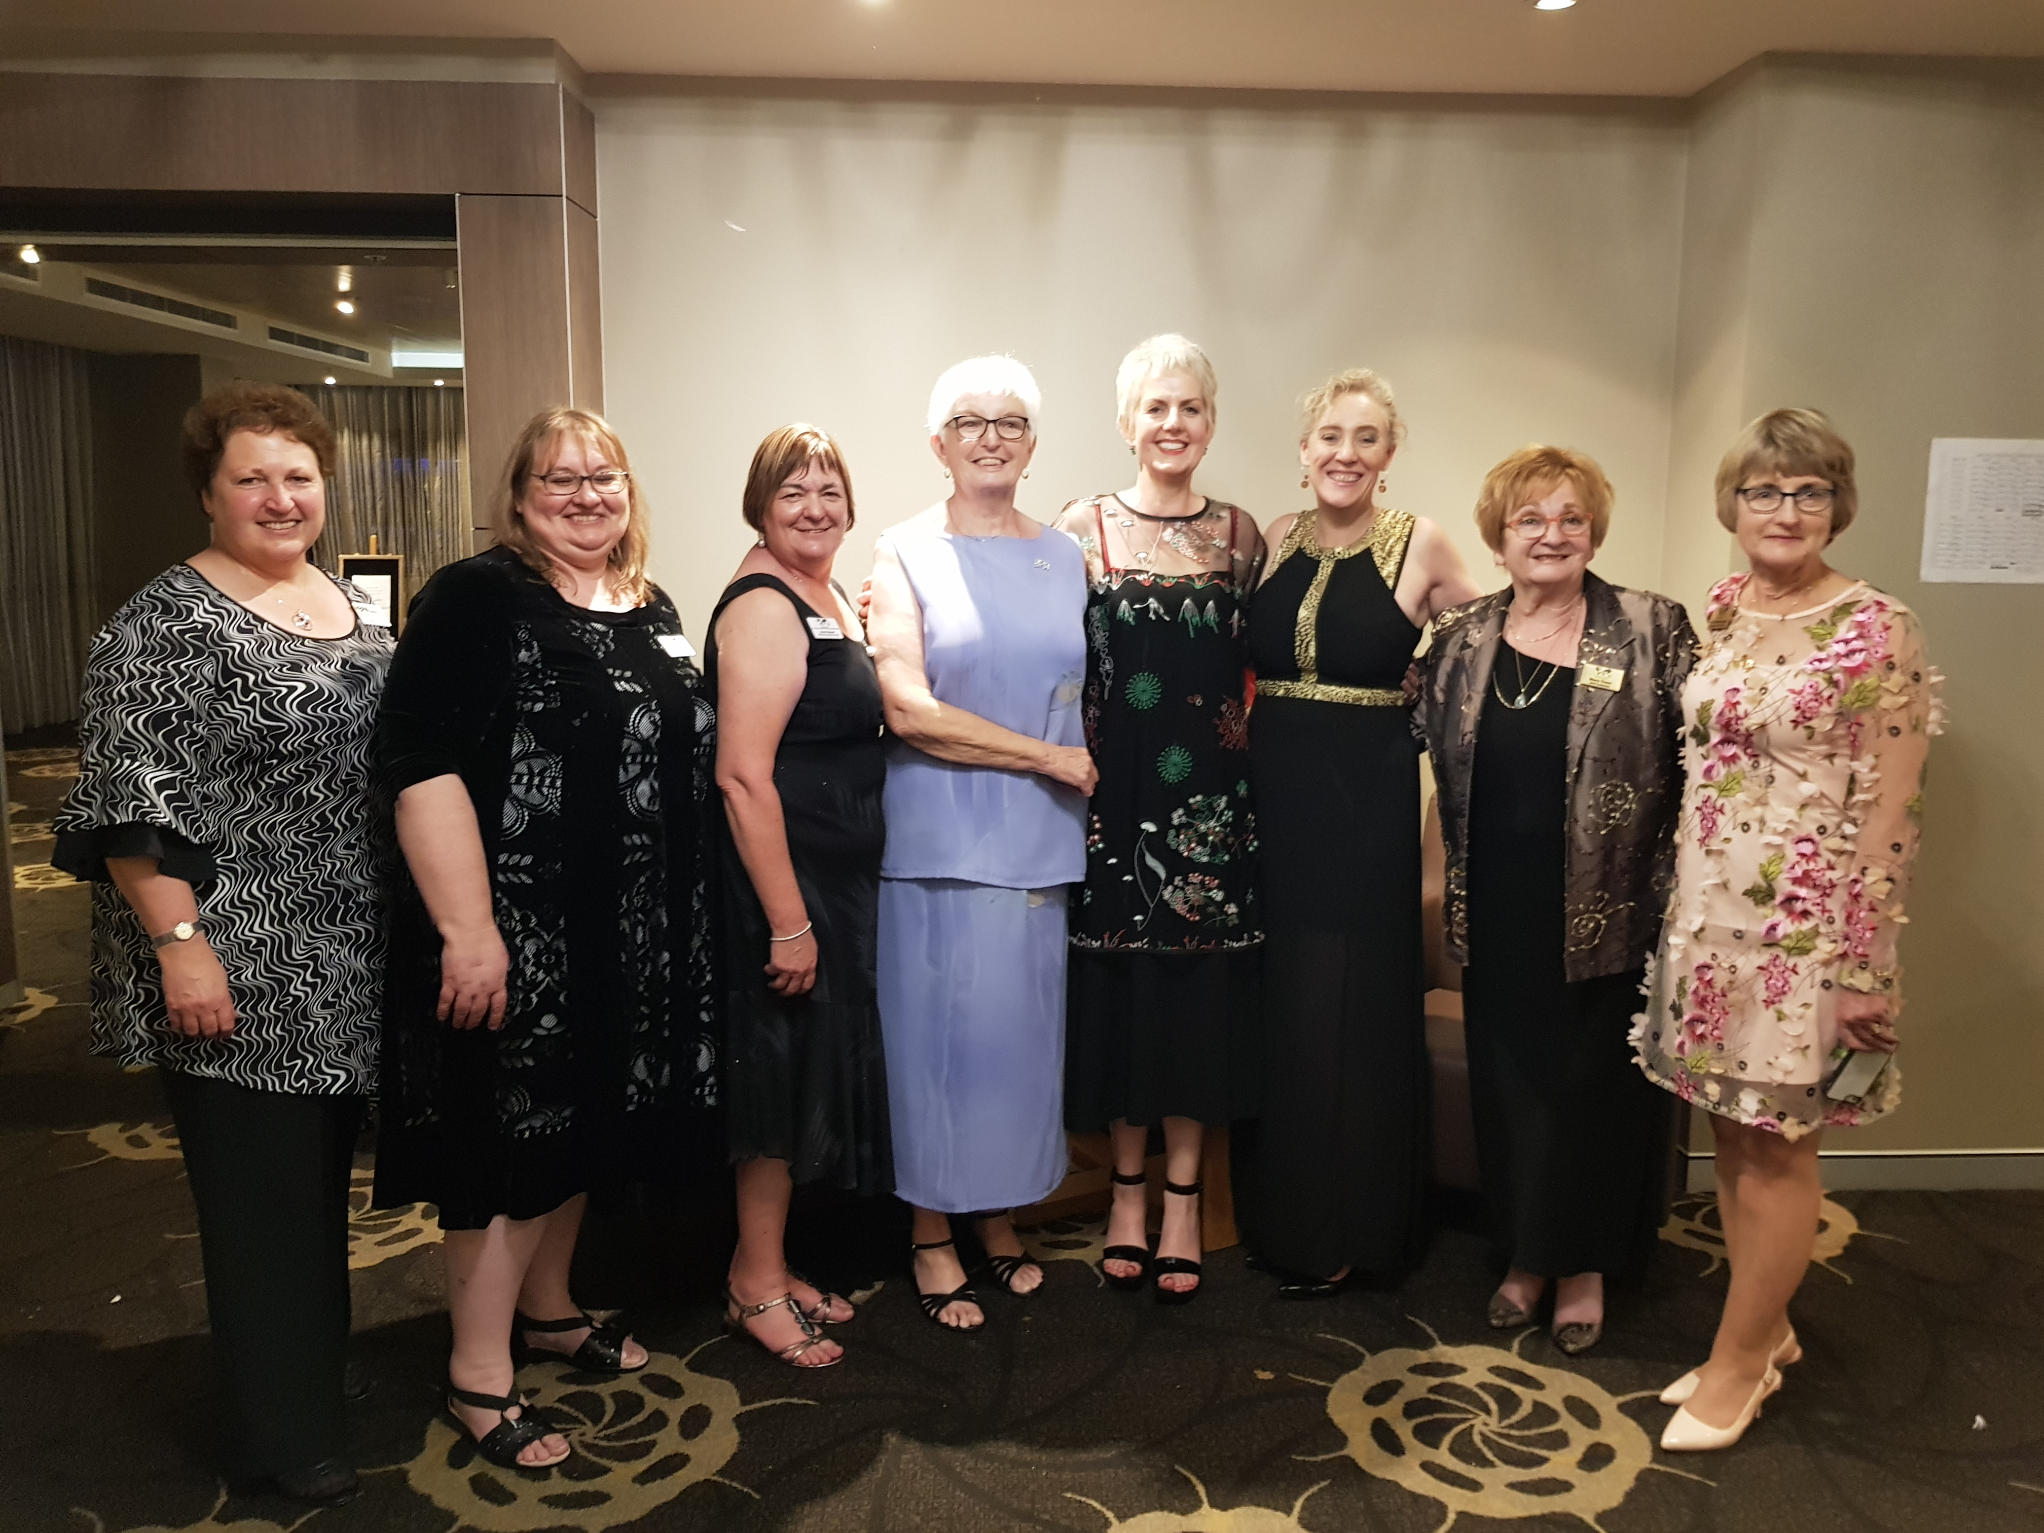
2016 - 2020
Building Policy Momentum Across Victoria
BPW members in Victoria updated at Club level regarding progress on consultations around the Bill
Catalyst to development of Victorian Presidents’ Meetings
Direct link to formation of Victorian Policy Committee
Notes:
I have spoken a lot about the reactivation of Victorian Presidents’ meetings and greater collaboration between Victorian Clubs. So I won’t go into that in detail again. And it is fair to say that our impetus has been greatly slowed over the last couple of years by the impacts of COVID and lockdowns.
Nonetheless, the Momentum developed by our participation in this consultation process played a large part in building collaboration and led the the formation of the Policy Committee.
Currently there are Policy statements in 3 key areas:
Leadership at all Career Stages
Supporting Health and Wellbeing at All Career Stages
Building Financial Independence at All Career Stages

Slide 12
February 2020
Victorian
Gender Equality Act passed
Requires the Victorian public sector, local councils and universities to take positive action towards achieving workplace gender equality.
Requires these organisations to consider and promote gender equality in their policies, programs and services.
BPW Members in the Parliament’s public gallery to watch the debate and celebrate the Enactment of the Bill
Notes:
The Act is essentially an exercise in the Victorian Government showing leadership – a key pillar of the overall Gender Equality Strategy.
So the first action by the Victorian Government was to legislate in those areas where it has direct control over the levers for Gender Equality and Women’s Empowerment. That is, the areas where it is the employer and can be held accountable.
But also areas that can demonstrate learnings and benefits replicable across the private and philanthropic sectors. And where government can help build markets and make the business case, like in procurement.

Slide 13
Victorian Gender
Equality Act 2020
“Defined entities” are required to:
Implement a Gender Equality Action Plan, which includes:
A workplace gender audit
Strategies for achieving workplace gender equality
Publicly report on progress
Promote gender equality in policies, programs and services that impact the public
Complete gender impact assessments

Slide 14
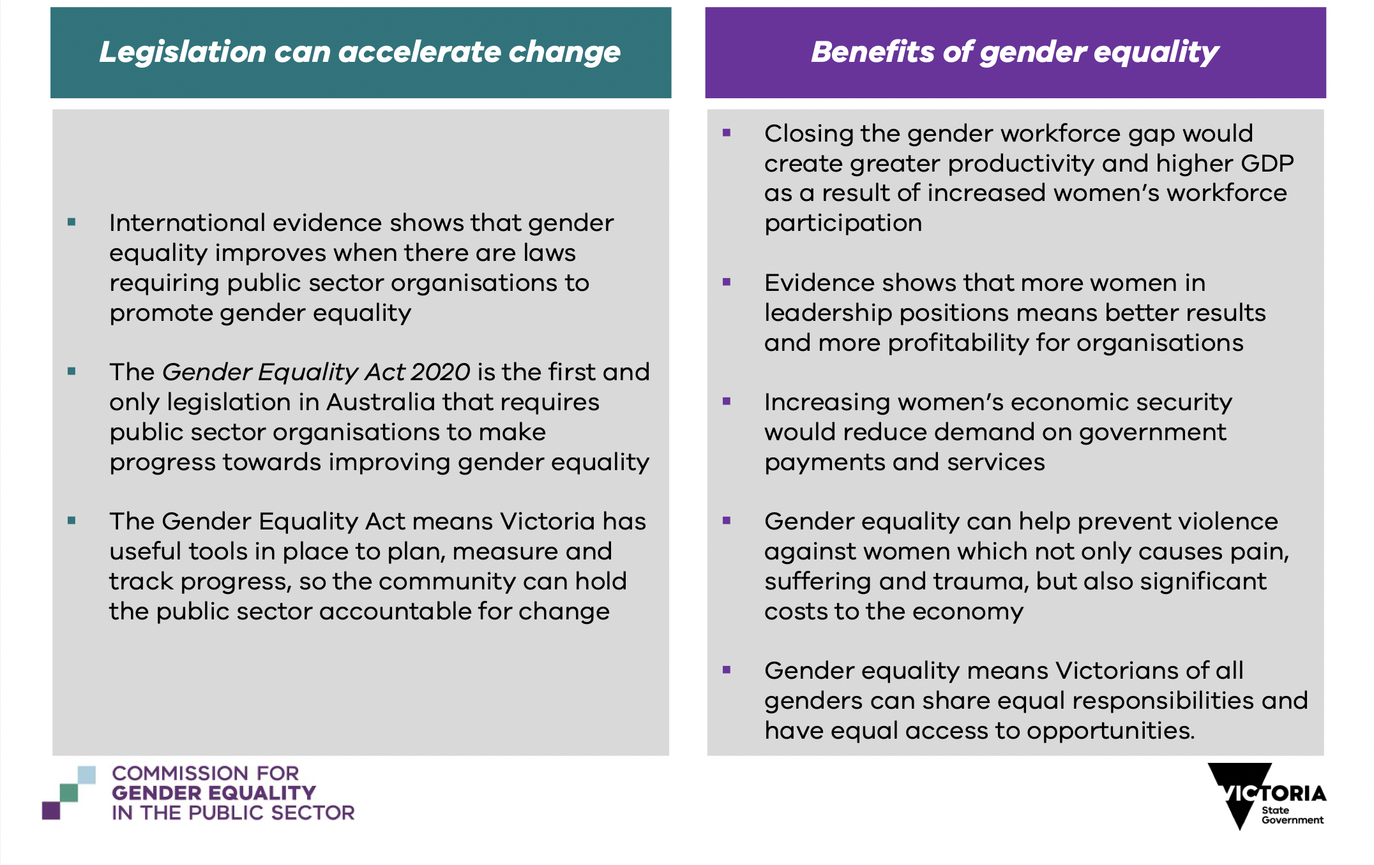
Notes:
Highlight the second paragraph in the Legislation Can Accelerate Change column.

Slide 15
March 2020
Act is Operational
BPW considered pitching to be part of the Panel of Providers
Notes:
Defer to Jacqueline on this slide.
This shows the extent to which a State initiative was escalated to an issue of National Policy interest.
Again reflecting the personal commitment and input of our National President and BPW Melbourne member Jacqueline. And the interest of our National Policy Director, Angela Tomazos.

Slide 16
September 2020
Commissioner
Appointed
The Public Sector Gender Equality Commissioner will:
Promote the objectives of the Act
Support defined entities to comply with the Act
Provide advice and education to encourage best practice
Resolve disputes in workplaces
Publish and share Gender Equality Action Plans and progress reports.
Dr Niki Vincent appointed as the First Commissioner
Niki is a well-known friend of BPW in SA
BPW Melbourne members congratulate Niki on the role

Slide 17
October 2021
Dr Niki Vincent
meets BPW Victoria
Dr Niki Vincent joins BPW Melbourne as a Special Guest Speaker
Followed BPW Melbourne’s Equal Pay Day event featuring Director of WGEA, the Hon. Mary Wooldridge, with participation from members across Victoria
This event once again open to all Victorian members

Slide 18
2021 -2022
Implementation
10 November 2021
Gender Equality Act Reporting Platform went live
31 March 2022
First Workplace Gender Audits under the Act due
Notes:
Note the second date was the day before yesterday at the time of this presentation.
So we are about to see the results of all the activity within Government controlled entities. Interesting times – watch this space!!

Slide 19
Six Years….
And Building
BPW became part of significant legislative change in Victoria
Seizing opportunities, taking the long view
Much work is still do be done on implementation of the Gender Equality Strategy in its entirety
BPW Australia, through its Victorian Clubs, has a seat at the table

