Slide 1
BPW Adelaide 1952-2019
BPW Adelaide advocates for women and develops leadership through building women's competence, capacity and confidence in their personal and professional arenas

Slide 2
BPW Adelaide turns 67 in 2019 BPW Australia turns 72 in 2019

Slide 3
BPW Australia Aims
To unite business, professional and
other working women across Australia

Slide 4
BPW Australia Aims
1. To work for women's:
economic independence
equal opportunity and representation in economic, civil and political life

Slide 5
BPW Australia Aims
2. To encourage and support women and girls to:
develop their professional and leadership potential
undertake lifelong education and training
use their abilities for the benefit of others, locally, nationally and internationally

Slide 6
BPW Australia Aims
3. To advocate:
for the elimination of all discrimination against women
for human rights and the use of gender-sensitive perspectives

Slide 7
BPW Australia Aims
4. To undertake:
national and international networking and co-operation
non-profit projects that help women gain economic independence
to present the views of Australian women to BPW International, responsible Australian authorities, governments, business and civil society

Slide 8
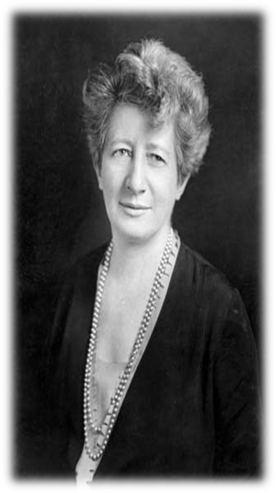
BPW History
Founder: Lena Madesin Phillips
Make no small plans – they have no power to stir the blood
Without economic security there can be no independence for women
BPW Adelaide: making a difference for over 65 years

Slide 9
BPW History
1919
1925
1930
1931
BPW established in USA
First BPW club in Australia
BPW International formed
BPWI HQ established in NY
BPW Adelaide: making a difference for over 65 years

Slide 10
BPW History
1946
1947
1952
2019
First BPWI congress in Brussels
BPW Australia formed
BPW Adelaide established
BPWI in ~100 countries
BPW Adelaide: making a difference for over 65 years

Slide 11
BPW International
BPW International works for global gender equality in power and decision-making
through our advocacy and UN participation
BPW develops the business, professional and leadership potential of women
through our advocacy, mentoring, networking, skill building and economic empowerment programs and projects around the world
BPW Adelaide: making a difference for over 65 years

Slide 12
Mentoring
Advocacy
Networking
Skill Building
Education
Economic Empowerment
Projects around the world
Legislative changes
BPW International
BPW Adelaide: making a difference for over 65 years

Slide 13
BPW’s international structure
BPW International
BPW Australia
BPW South Australia
BPW Adelaide
BPW members are members of BPW Australia and BPW International
BPW Adelaide: making a difference for over 65 years

Slide 14
BPW International
Goals
To obtain for women:
equality
education
economic empowerment
personal development
political awareness
BPW Adelaide: making a difference for over 65 years

Slide 15
BPW International
takes action to achieve women’s equality in social, economic, community and political terms
represents the voice of women in around 100 countries
has full Consultative Status at the United Nations
BPW Adelaide: making a difference for over 65 years

Slide 16
BPW International also has
Category 1 Consultative Status with ECOSOC, the United Nations Economic and Social Council
Consultative Status with
UNESCO, the United Nations Educational, Scientific and Cultural Organisation
the Board of the United Nations Children’s Fund
the International Labour Office
the United Nations Industrial Development Organisation
and the World Health Organisation
BPW Adelaide: making a difference for over 65 years

Slide 17
BPW International works closely with
the Commission on Human Rights
the Commission on the Status of Women
the Food and Agriculture Organisation
the International Fund for Agricultural Development
the Council of Europe
and other specialised agencies
BPW Adelaide: making a difference for over 65 years

Slide 18
BPW International has accredited BPW representatives attending meetings at
UN Headquarters in New York, Vienna, Geneva
UN regional offices (UNECA, UNECE, UNESCAP, UNESCWA, UNECLAC)
UNESCO, UNICEF, ILO, WHO, UNCTAD, UNIDO, FAO, UN DPI
Council of Europe and the European Women’s Lobby
Our representatives convey BPW’s advocacy positions to these bodies and report back to members and to the BPWI Congress
BPW Adelaide: making a difference for over 65 years

Slide 19
BPW Values
BPW Australia is a non-profit organisation for women, with voluntary membership and leadership
Our procedures are democratic and inclusive of all members, and our actions honour our history and protect our reputation
BPW Adelaide: making a difference for over 65 years

Slide 20
BPW members value:
equity and justice, building harmony, applying rules fairly to everyone
honesty and integrity, being professional, meeting our obligations and taking responsibility
transparency and accountability, building trust, making decisions based upon facts
kindness and respect, being inclusive, acknowledging and respecting our differences
teamwork and cooperation, encouraging discussion and debate but seeking agreement
BPW Adelaide: making a difference for over 65 years

Slide 21
BPW Values
These BPW values guide actions and decision-making by BPW International, BPW Affiliates and all BPW committees
BPW Adelaide: making a difference for over 65 years

Slide 22
BPW Australia
Our Purpose
BPW Australia takes action for women's equality – at work, on boards, in leadership
Our Mission
BPW: supports and actively promotes personal development; provides a forum for the exchange of ideas, knowledge and experience; and lobbies on issues affecting women
BPW Adelaide: making a difference for over 65 years

Slide 23
BPW Australia
Women working together
Our advocacy, projects, programs and partnerships focus on issues that affect women and workplaces such as:
pay inequity
paid parental leave
accessible and affordable childcare
support for women’s refuges
domestic violence
BPW Adelaide: making a difference for over 65 years

Slide 24
BPW Australia
Membership
BPW Australia welcomes as members women in paid and voluntary work, including women who used to work and women who aspire to work
BPW membership includes employers and employees, corporate women and small business women, women in professions and trades, and from the non-profit and government sectors
BPW Adelaide: making a difference for over 65 years

Slide 25
BPW Australia
is consulted by the Federal Government, and by many national corporations and industries, on policies and laws which impact on women
is represented on many consultative bodies at a national level including COSBOA (the Council of Small Business Organisations of Australia) and the Micro-Business Consultative Council
BPW Adelaide: making a difference for over 65 years

Slide 26
BPW Australia
leads one of the four women's secretariats, each of which is a national consortium of women's organisations established to represent women's views to the national government
economic Security for Women (eS4W) conducts research into women's financial independence
BPW Adelaide: making a difference for over 65 years

Slide 27
BPW Australia
has been invited to join Australian government delegations to international UN and APEC meetings
represents Australian women in the BPW International delegation to the United Nations Commission on the Status of Women
BPW Adelaide: making a difference for over 65 years

Slide 28
BPW Adelaide
BPW Adelaide
advocates for women
and
develops leadership through building women's competence, capacity and confidence in their personal and professional arenas
BPW Adelaide: making a difference for over 65 years

Slide 29
BPW Adelaide
Established 1952, still going strong
Fostered BPW clubs around South Australia
Has a long history of effective advocacy, community leadership and representing working women
Members have served BPW at state, national and international levels
BPW Adelaide: making a difference for over 65 years

Slide 30
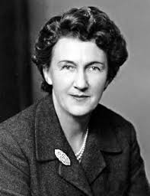
Dame Nancy Buttfield DBE In 1952 Mrs H Kennedy established BPW Adelaide, then called the Business and Professional Women’s Club of Adelaide In 1954, Nancy Buttfield was elected Club President at the first Annual General Meeting; she was subsequently elected to Parliament In 1972 she was made a Dame Commander of the Order of the British Empire (DBE)
BPW Adelaide: making a difference for over 65 years

Slide 31
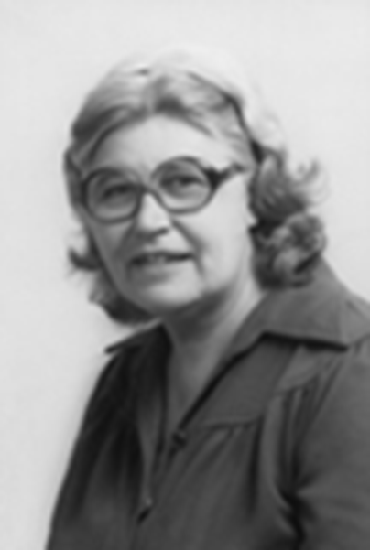
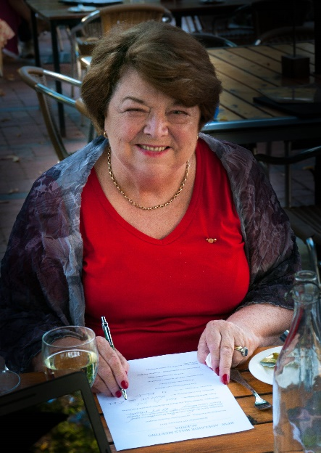
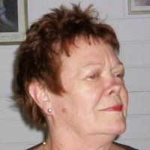
BPW Adelaide Members awarded National Australia Day Honours Heather Southcott AM Sheila Evans OAM Glenys Jones OAM
BPW Adelaide: making a difference for over 65 years

Slide 32
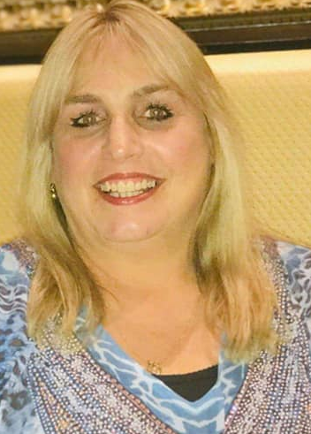
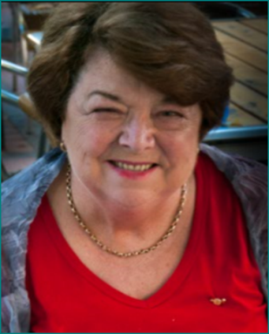
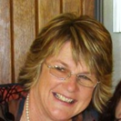
BPW Adelaide Members recognised on the SA Women’s Honour Roll Julie Menadue 2008 Heather Southcott AM 2013 Sheila Evans OAM 2015 Gillian Lewis 2015
BPW Adelaide: making a difference for over 65 years

Slide 33
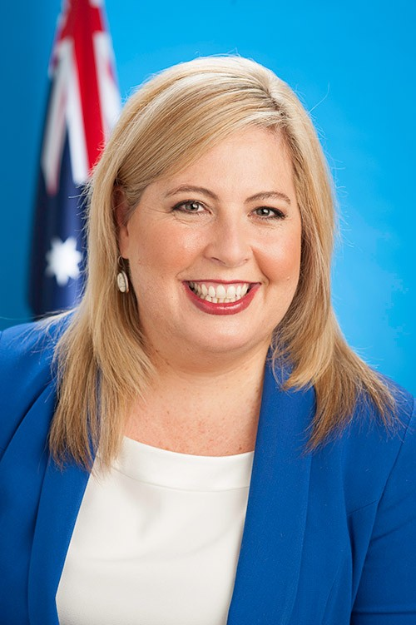
BPW Adelaide Members recognised with the SA Women hold up Half the Sky Award Katrine Hildyard 2012 Katrine was recognised for her work on the Australian Services Union’s community sector equal pay campaign
BPW Adelaide: making a difference for over 65 years

Slide 34
BPW Adelaide Members elected to the Australian Parliament Senator Dame Nancy Buttfield DBE In 1995, Nancy became the first woman to serve as a South Australian Senator In 1972 she was made a Dame Commander of the Order of the British Empire (DBE)
BPW Adelaide: making a difference for over 65 years

Slide 35
BPW Adelaide Members elected to the South Australian Parliament Heather Southcott AM elected representative for Mitcham in 1982 as National Leader of the Australian Democrats, was the first woman in South Australia to lead a political party
BPW Adelaide: making a difference for over 65 years

Slide 36
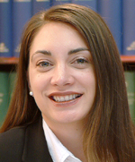
BPW Adelaide Members elected to the South Australian Parliament The Hon Michelle Lensink MLC elected to the Legislative Council in 2003 Minister for Human Services, Minister for the Status of Women and Deputy Liberal Leader in the Legislative Council and a continuing member of BPW Adelaide
BPW Adelaide: making a difference for over 65 years

Slide 37
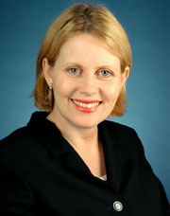
BPW Adelaide Members elected to the South Australian Parliament Dr Trish White MP elected representative for Taylor in 1994 served for 16 years
BPW Adelaide: making a difference for over 65 years

Slide 38
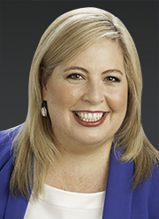
BPW Adelaide Members elected to the South Australian Parliament Katrine Hildyard MP Katrine Hildyard MP was elected Member for Reynell in the South Australian Parliament in 2014 She is currently the Shadow Minister for the Status of Women
BPW Adelaide: making a difference for over 65 years

Slide 39
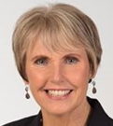
BPW Adelaide Members standing for election to the South Australian Parliament Angela Vaughan Angela was a candidate for Colton in the 2018 state election
BPW Adelaide: making a difference for over 65 years

Slide 40
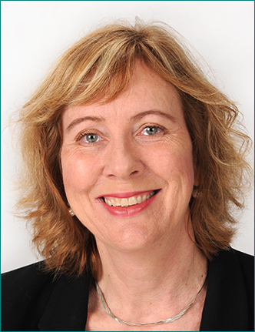
BPW Adelaide Members currently serving on Local Councils Yvonne Todd Yvonne was elected councillor for Babbage Ward in the City of Mitcham in 2015 and was re-elected in 2018
BPW Adelaide: making a difference for over 65 years

Slide 41
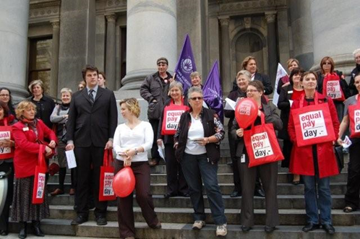
BPW Campaigns Pay equity: Equal Pay Campaign BPW Adelaide conducts annual events to mark Equal Pay Day www.equalpayday.com
BPW Adelaide: making a difference for over 65 years

Slide 42
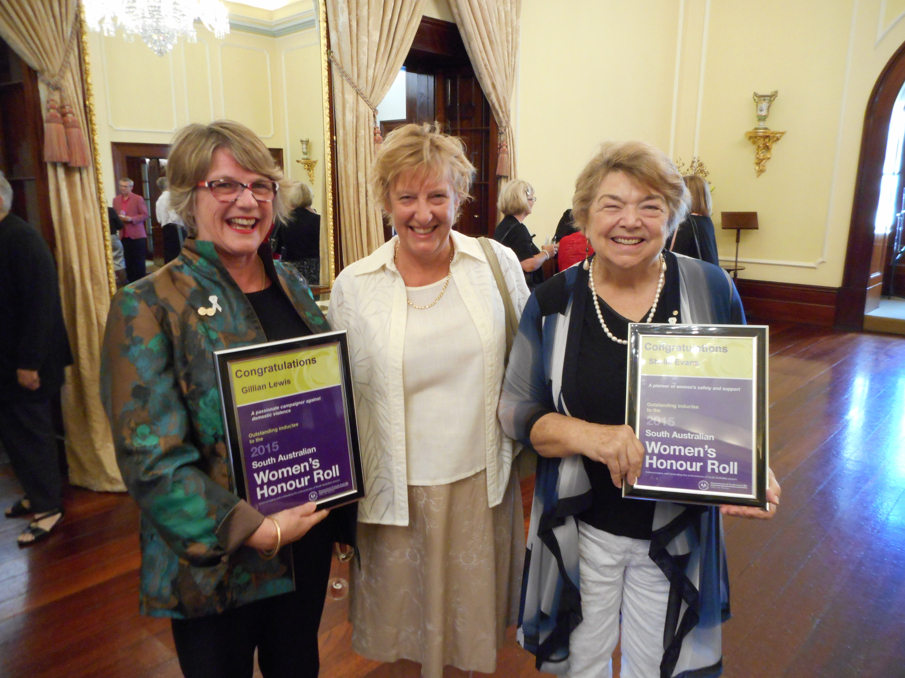
White Ribbon Campaign BPW Adelaide member Gillian Lewis founded the White Ribbon Breakfast Committee in 2008 by bringing women’s organisations together to advocate against DV Gillian has been Co-convenor of the Committee since the first breakfast, and Sheila Evans OAM was a dedicated member of the Committee Gillian and Sheila were recognised by inclusion on the SA Women’s Honour Roll in 2015
BPW Campaigns
BPW Adelaide: making a difference for over 65 years

Slide 43
Campaign to Recognise Heather Southcott AM Heather was a past BPW President and a leader of women In 2017 BPW Adelaide sought to have a room at the University of Adelaide named after Heather because rooms are almost always named after men This proved to be too expensive and out of reach, so we worked with the University of SA to establish the BPW Adelaide Heather Southcott Memorial Scholarship which rewards a post-graduate female pharmacy student with a $5000 grant
BPW Campaigns
BPW Adelaide: making a difference for over 65 years

Slide 44
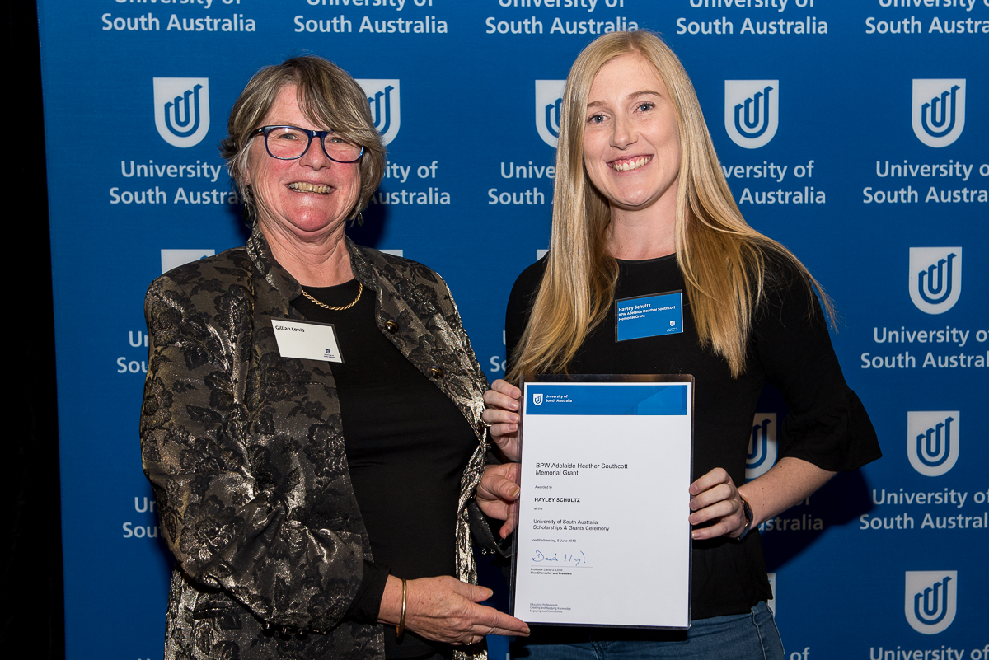
BPW Adelaide Heather Southcott Memorial Scholarship The $5000 scholarship will be awarded annually from the Heather Southcott Scholarship Fund administered by UniSA The 2019 inaugural scholarship winner is PhD student Hayley Schultz who is conducting research into oral chemotherapy Donations to the Fund to honour Heather are welcome
BPW Campaigns
BPW Adelaide: making a difference for over 65 years

Slide 45
Decriminalisation of Sex Work and Abortion: advocacy for both bills Paid Parental Leave: Paid Maternity Leave Campaign, became a Paid Parental Leave Campaign in 2009 Mentorship: I need Mentors booklet and tool kit led by BPW Adelaide Work and family balance: Snakes and Ladders, working with OFW
Other BPW Campaigns
BPW Adelaide: making a difference for over 65 years

Slide 46
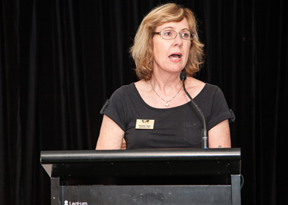
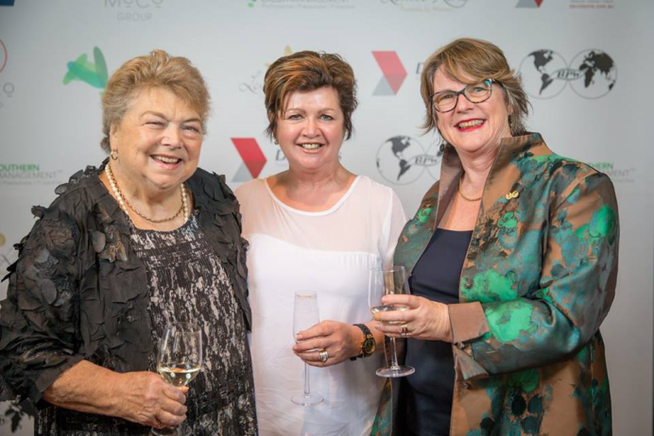
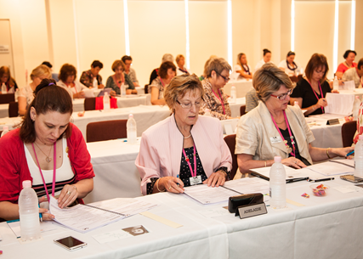
BPW Australia Conferences hosted in Adelaide National Conferences hosted by BPW Adelaide: 1957, 1972, 2000 … and soon 2020 National Policy Summits hosted by BPW Adelaide: 2011, 2015 bpw.com.au
BPW Adelaide: making a difference for over 65 years

Slide 47
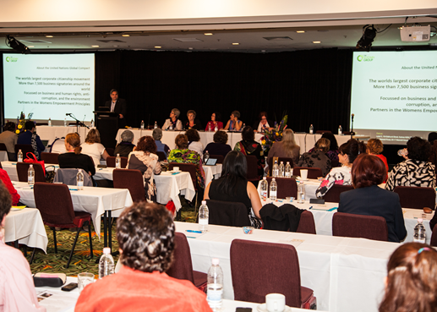
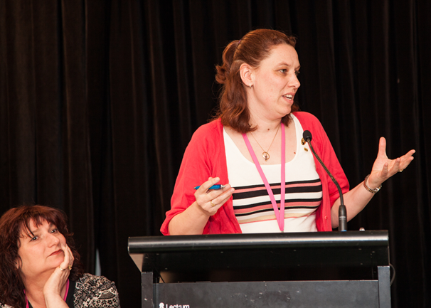
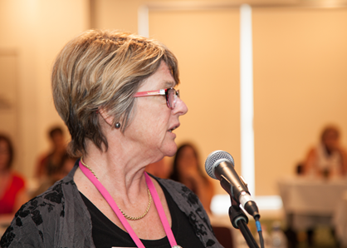
BPW Australia Conferences attended by BPW Adelaide BPW Adelaide sends a voting delegation of members to each BPW Australia National Conference BPW Adelaide members are active participants
BPW Adelaide: making a difference for over 65 years

Slide 48
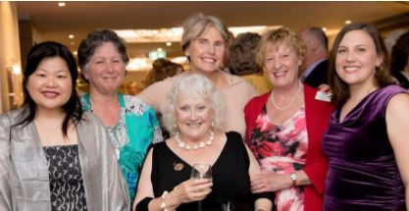
BPW Australia Conference 2018 in Queensland BPW Adelaide sent a delegation of 6 members and put forward 3 policy resolutions for debate and voting All 3 resolutions were passed: pay transparency eldercare leave superannuation payments for low incomes and became part of BPWA’s national advocacy platform for the 2019 federal election
BPW Adelaide: making a difference for over 65 years

Slide 49
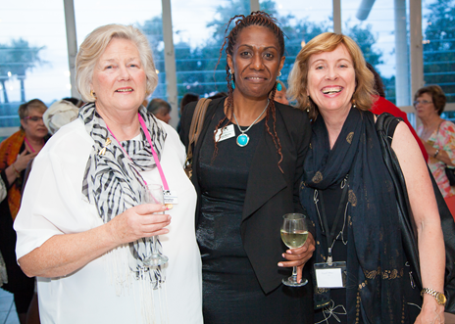
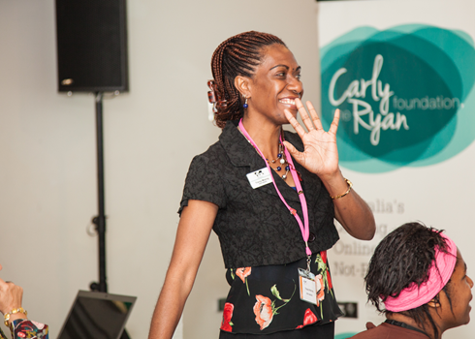
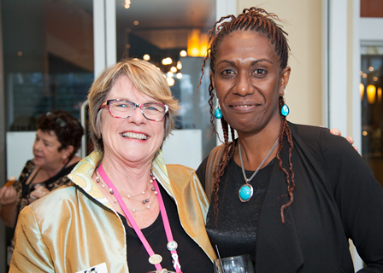
BPW Australia Conferences attended by BPW Adelaide Tracey Masing from PNG: BPW Adelaide sponsored our mentee member to attend the 2013 National Conference
BPW Adelaide: making a difference for over 65 years

Slide 50
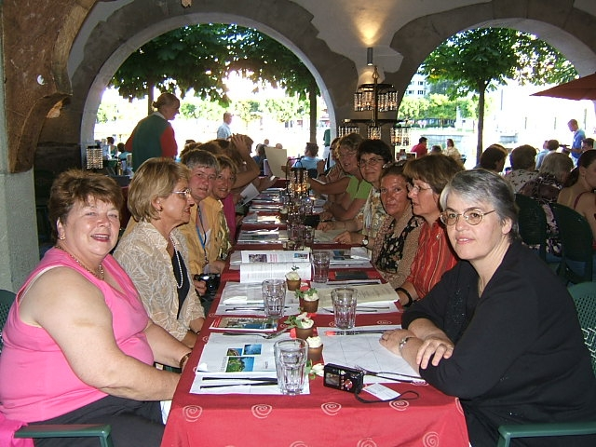
BPW International Congresses attended by BPW Adelaide members BPW Adelaide members have been BPW Australia voting delegates at BPW International Congresses www.bpw-international.org
BPW Adelaide: making a difference for over 65 years

Slide 51
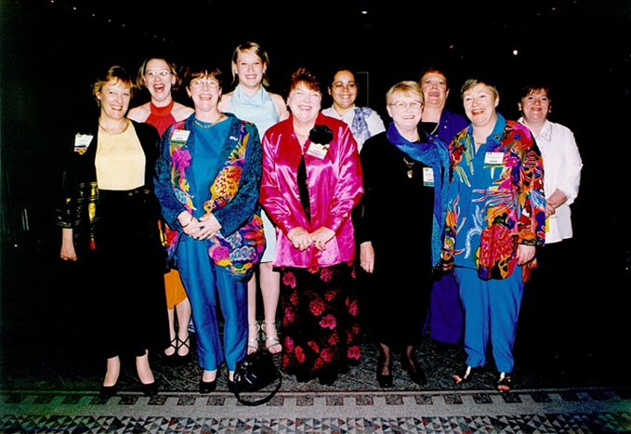
BPW International Congresses attended by BPW Adelaide members BPW Adelaide members have been BPW Australia delegates at BPW International Congresses 2002 Melbourne
BPW Adelaide: making a difference for over 65 years

Slide 52
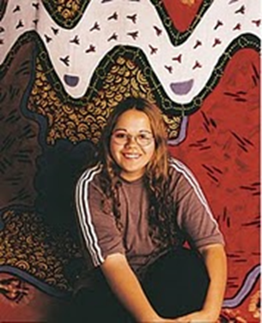
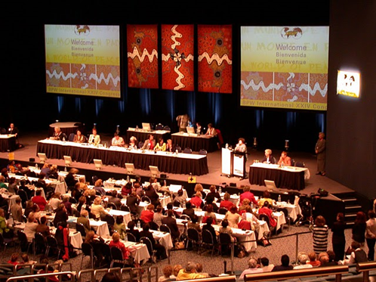
BPW International Congresses attended by BPW Adelaide members BPW Adelaide mentee Violet Buckskin was declared our Artist in Residence for the 2002 BPW International Congress Violet’s artwork formed the backdrop to the Congress 2002 Melbourne
BPW Adelaide: making a difference for over 65 years

Slide 53
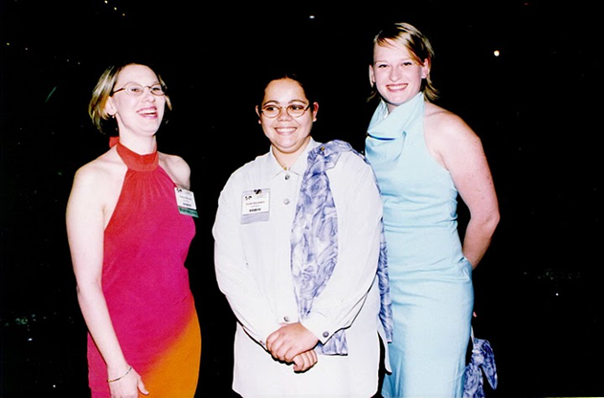
BPW International Congresses attended by BPW Adelaide members BPW Adelaide mentee Violet Buckskin with BPW Adelaide Young BPWs Kerryl Murray McGlennon and Alison Findlay 2002 Melbourne
BPW Adelaide: making a difference for over 65 years

Slide 54
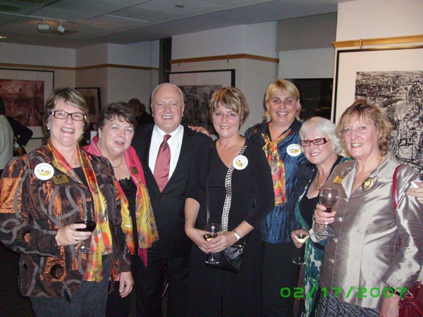
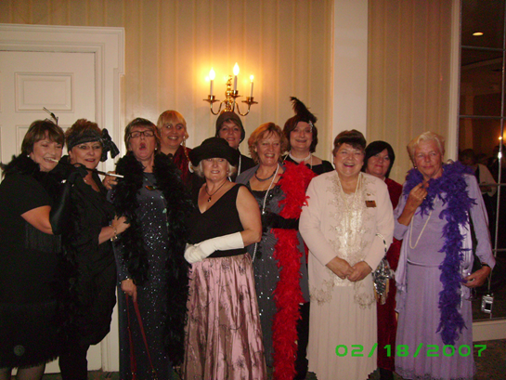
BPW Adelaide members have attended the Commission on the Status of Women in New York BPW International holds international panel presentations and celebratory events concurrently with CSW
BPW Adelaide: making a difference for over 65 years

Slide 55
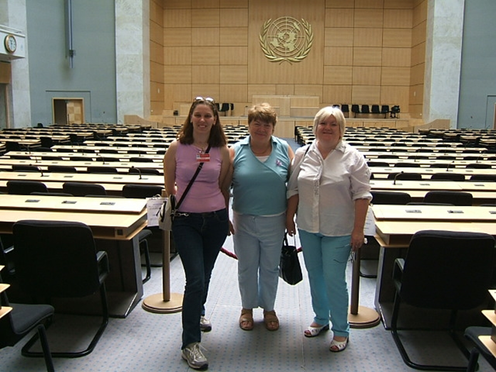
BPW Adelaide members have visited the United Nations in Geneva BPW International has official representation on many UN commissions and agencies
BPW Adelaide: making a difference for over 65 years

Slide 56
BPW Adelaide Presidents 1952-2017
H Kennedy | 1952-1954
Nancy Buttfield | 1954-1955
E Campbell | 1955-1957
T Mills | 1957-1959
F Gallagher | 1959-1961
I Hembrow, M North | 1961-1962
C Murphy | 1962-1963
J Richardson | 1963-1964
A Taylor | 1964-1966
M Young | 1966-1967
T Segerlind | 1967-1969
G McNair | 1969-1971
M Kyd | 1971-1973
B Jarvis | 1973-1974
Mary Kyd, B Jarvis | 1974-1975
I Wall | 1975-1976
Pat St.Clair | 1976-1978
E Kelly | 1978-1979

Slide 57
BPW Adelaide Presidents 1952-2017
Mary Kyd | 1979-1980
Recess | 1981
Brenda Nettle | 1982-1984
Filomeno Bruno-Joseph | 1985-1989
Heather Southcott AM | 1990-1993
Jean Murray | 1993-1995
Perla Soberon-Brittle | 1995-1998
Gillian Lewis | 1998-2001
Tina Nicholls | 2001-2002
Denise Rieniets | 2003 -2005
Kerryl Murray | 2006-2010
Louise Sparks | 2010-2011
Gillian Lewis | 2011-2012
Helena Marich | 2012-2013
Heather Anderson | 2013-2014
Jean Murray | 2014-2015
Perla Soberon-Brittle | 2015-2016
Angela Vaughan | 2016-2019

Slide 58
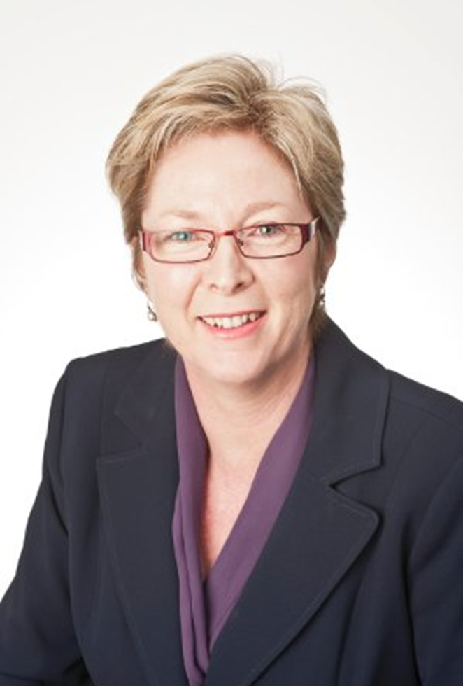
Heather Jensen President of BPW Adelaide Heather is director and Financial Planner with Carrington Financial Services SA Pty Ltd She has been working in the financial services industry for over 30 years starting as an Accountant working for Chartered Accounting firms and in the corporate world and moving to Financial Planning 15 years ago Her passion is to assist women become financially independent
BPW Adelaide: making a difference for over 65 years

Slide 59
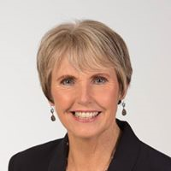
Angela Vaughan Past President of BPW Adelaide Angela is a teacher, community worker and parent of three young adults During 2019 Angela has been teaching in an Aboriginal community in the APY Lands, and attending BPW meetings by phone Her aspiration is to foster the recognition of our power within our community to: support, work, advocate and undertake social reform for all women inclusive of our first Australians, multicultural groups and women of diverse needs
BPW Adelaide: making a difference for over 65 years

Slide 60
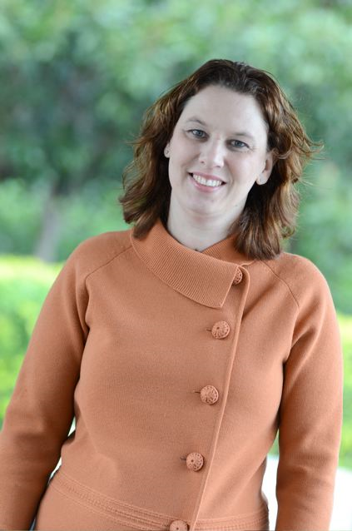
Kerryl Murray McGlennon BPW Adelaide Treasurer and Past President Kerryl has served on the club and state Executives and as the SA representative on the BPW Australia Board She has represented BPW Australia at 4 International Congresses as a delegate, workshop presenter and volunteer Kerryl is a Graduate Accountant in the public sector, after studying for a career change, and has been a regular writer for an international widows’ blog
BPW Adelaide: making a difference for over 65 years

Slide 61
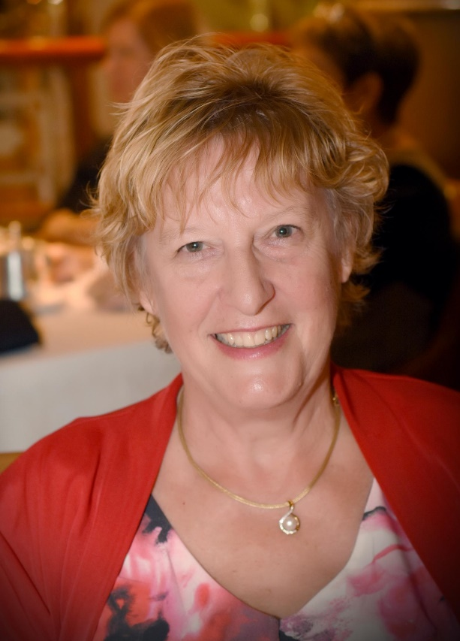
Dr Jean Murray BPW Adelaide Club Secretary and Past President Jean has served as BPW Adelaide President, BPW South Australia Representative on the BPW Australia Board, Vice President Policy and Executive Secretary of BPW Australia, and Executive Secretary of BPW International Jean is an Adjunct Academic at the College of Medicine, Flinders University, and works with the Gender Consortium to support their women’s empowerment programs She was a Telstra Businesswomen’s Award Finalist in 2009
BPW Adelaide: making a difference for over 65 years

Slide 62
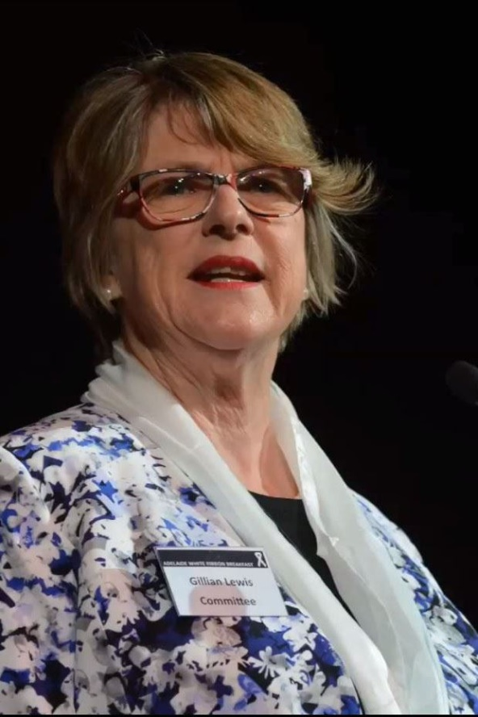
Gillian Lewis BPW Adelaide Communications Officer and Past President Gillian has served as BPW Adelaide President and BPW South Australia Representative on the BPW Australia Board Gillian is a Senior Policy Adviser to SA Health Gillian has been a Board member of Playgroup SA since 2008 and its President since 2012, and was twice a finalist for the BPW Australia Jean Arnot Award in 2013 and 2018
BPW Adelaide: making a difference for over 65 years

Slide 63
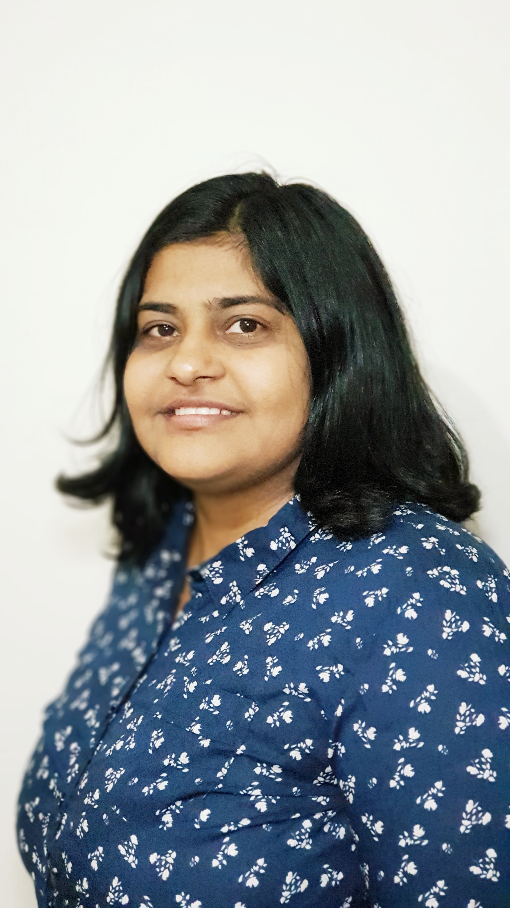
Isha Kotak Member of BPW Adelaide Isha is a new member of BPW Adelaide who was elected as a member of the cmgmtcom in 2019 She is a Social Worker who is passionate about gender equality Isha is keen to bring social change and protect women and child rights
BPW Adelaide: making a difference for over 65 years

Slide 64
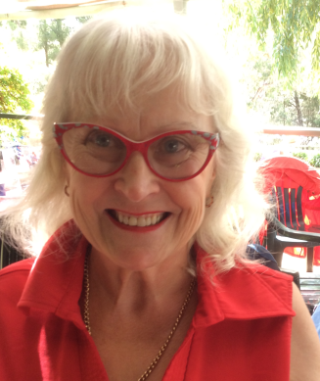
Judy Halleday Member of BPW Adelaide Judy was a long term member of BPW Adelaide Hills and a mentor for BPW Heysen A member of BPW for 20 years and a state finalist of the Telstra Businesswomen’s Awards in 2002, Judy has attended the UN Commission on the Status of Women in New York Judy owned ran her own company for 20 years, providing community services for persons with disabilities, age care and families She has served on many NGOs Boards and committees, representing them at international conferences
BPW Adelaide: making a difference for over 65 years

Slide 65
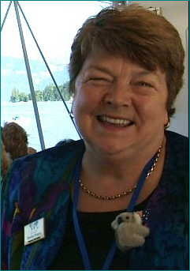
Sheila Evans JP OAM (deceased) BPW Adelaide Past President Sheila has served as BPW Adelaide President, BPW South Australia Representative on the BPW Australia Board, National Director of Membership and Executive Secretary of BPW Australia, and Coordinator of Committees for BPW International Sheila was awarded an OAM in 2003 for her community service in developing support services for women, advocating for women prisoners and raising awareness of social justice issues; she died in July 2018
BPW Adelaide: making a difference for over 65 years

Slide 66
Mariam Hii Member of BPW Adelaide Mariam is passionate about social justice; from a corporate background, she became a community development professional in the non-profit sector Mariam has managed DV projects internationally and in Australia, with a focus on CALD communities She is a Committee Member of the Social Impact Measurement Network Australia, SA Chapter and a White Ribbon Advocate for SA
BPW Adelaide: making a difference for over 65 years

Slide 67
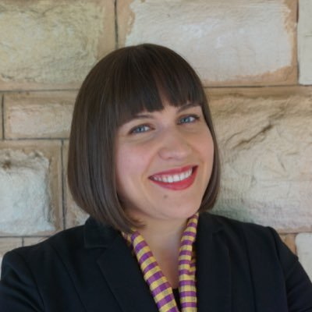
Alison Collins Member of BPW Adelaide Alison works in government communications and has qualifications in Law and International Studies She has interests in social justice and leadership development With Mariam, Alison led and won the BPW Adelaide 2020 National Conference bid
BPW Adelaide: making a difference for over 65 years

Slide 68
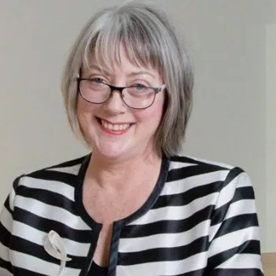
Wendy Teasdale-Smith Member of BPW Adelaide Wendy is an experienced board member, an academic and an executive coach with her own public speaking business: What’s The Stuff Wendy is the South Australian coordinator for Women on Boards Australia She was CEO of SATAC 2011-2016 and South Australia’s Telstra Business Woman of the Year, Community Category, in 2006
BPW Adelaide: making a difference for over 65 years

Slide 69
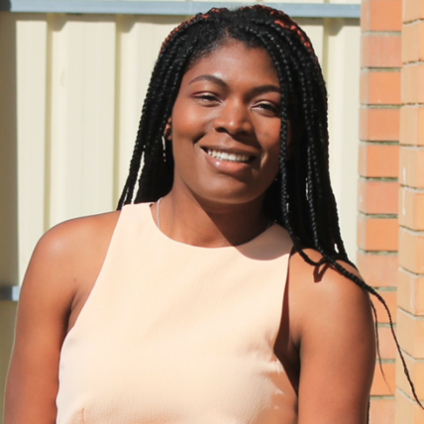
Ethel Osazuwa Member of BPW Adelaide Ethel is a member of BPW Adelaide Ethel is a young professional with international experience and interests in social policy and community development
BPW Adelaide: making a difference for over 65 years

Slide 70
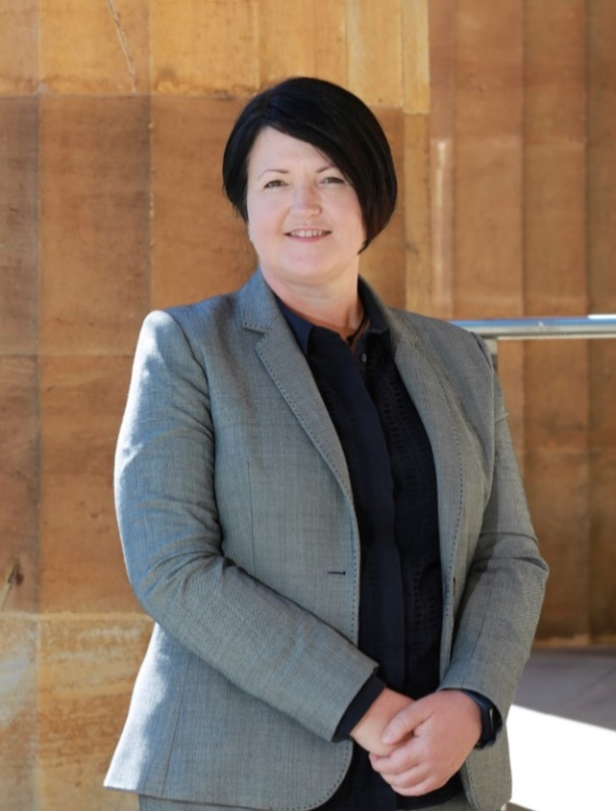
Elise Thomson Member of BPW Adelaide Elise is a solicitor primarily practicing in Family Law, Wills and Estates and Conveyancing; she is located in Port Adelaide but also services the southern, eastern and CBD areas Elise has a business, accounting and resources sector background and is an avid scuba diver in her spare time
BPW Adelaide: making a difference for over 65 years

Slide 71
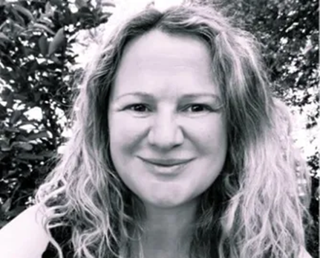
Penny Lello Member of BPW Adelaide Penny is an experienced executive leader, facilitator and coach Penny is a certified Advanced Meditation Teacher and runs her own change management business: Deepening Change
BPW Adelaide: making a difference for over 65 years

Slide 72
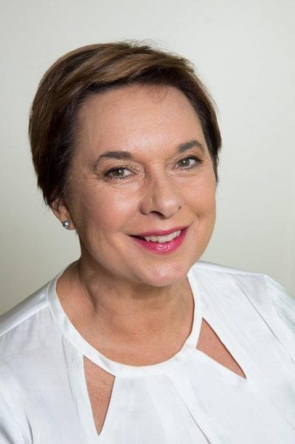
Liz Davies Member of BPW Adelaide Liz is a longterm member of BPW Adelaide and founding President of BPW Alice Springs Liz was the also the founding President of Self Storage Association of Australia and established Self Storage Australia in 1986
BPW Adelaide: making a difference for over 65 years

Slide 73
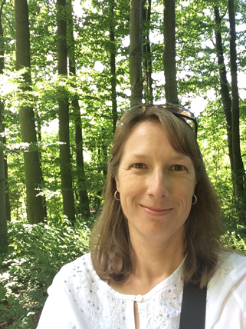
Verena Colby Member of BPW Adelaide Verena is a member of BPW Adelaide Verena has special interests in helping young women living with disabilities in rural and remote areas and the LGBTQI community to build capacity and increase resilience Her background in rehabilitation and health services management has helped to start new programs and to support others that provide support to families and children
BPW Adelaide: making a difference for over 65 years

Slide 74
Perla Soberon Brittle BPW Adelaide Past President Perla has previously served as BPW Adelaide President and BPW South Australia Representative on the BPW Australia Board, and as the National Director of Membership of BPW Australia Perla is a Fellow of the Institute of Certified Bookkeepers Australia, a Member of the Australian Institute of Company Directors, and serves on several community boards
BPW Adelaide: making a difference for over 65 years

Slide 75
Yvonne Todd Longterm member of BPW Adelaide Yvonne is a local councillor in the City of Mitcham and is active in disability advocacy Yvonne served as Vice President Policy for BPW Australia 2004-2007 and as BPW Australia’s Representative on the Economic Security for Women National Alliance in 2003
BPW Adelaide: making a difference for over 65 years

Slide 76
Stacey Nelan Stacey Nelan is the Workplace Program Advisor for White Ribbon Australia and a became a White Ribbon Advocate in 2016 She is an accomplished speaker on domestic and family violence in Australia and the White Ribbon Workplace Accreditation Program
BPW Adelaide: making a difference for over 65 years

Slide 77
Lila Loielo Lila completed her Honours in Psychology in 2018 She is currently spreading her wings in London
BPW Adelaide: making a difference for over 65 years

Slide 78
Dr Sandy Bradley Sandy is a registered nurse with several tertiary and post-graduate degrees Sandy thrives on research and education; her specialty area is aged and end of life care and the choices women make Sandy wouldn't be where she is today without the belief, strength and commitment of many female mentors, including those at BPW
BPW Adelaide: making a difference for over 65 years

Slide 79
Viv Hazel Streeter Viv transferred to BPW Adelaide from BPW Adelaide Hills and has contributed to the work of BPW at national and international levels Viv was recognised by BPW International at the BPW International Congress in Jeju, Korea in 2013
BPW Adelaide: making a difference for over 65 years

Slide 80
BPW Adelaide Hills and BPW Heysen
BPW Adelaide Hills was established in 1995 and closed in 2017
BPW Heysen was established in 2016 and chartered in 2017; it closed in 2018
Some BPW Adelaide Hills and BPW Heysen members transferred to BPW Adelaide when their club closed
BPW Adelaide Hills won funding for a Crime and Community Safety SA grant in 2011-12 to provide a series of local school workshops on prevention of cyberbullying, in conjunction with Carly Ryan Foundation CEO Sonya Ryan
Sonya Ryan was a keynote speaker at the BPW Australia Conference in New South Wales in 2013

Slide 81
BPW South Australia State Representatives
Pt Lincoln | Jenny Chillingworth | 1985-1988
Pt Lincoln | Fay Goldsworthy | 1988-1992
Adelaide Hills | Coralie Pridmore | 1992-1996
Adelaide | Jean Murray | 1996-1999
Adelaide Hills | Sheila Evans | 1999-2002
Adelaide | Gillian Lewis | 2002-2007
Adelaide Hills | Valerie Bonython | 2007-2010
Adelaide | Perla Soberon Brittle | 2010-2013
Adelaide | Kerryl Murray McGlennon | 2013-2015
Adelaide | Sunita Miranda | 2016-2017
Adelaide | Jean Murray | 2018-2019
Adelaide | Angela Vaughan | 2019

Slide 82
Dr Jean Murray BPW Adelaide Club Secretary Jean received the Jean Arnot Award, BPW Australia’s highest accolade, at the 2016 BPW Australia National Conference Jean served on the SA Government Women’s Advisory Council 1997-2001 and as a Trustee on the SA Women’s Trust 2003-2008
BPW Adelaide: making a difference for over 65 years

Slide 83
BPW Adelaide
What world do you want to shape?
What world do you want to shape?
Take action for women’s equality
Join us on the first Wednesday of each month:
Office for Women
101 Grenfell St Adelaide
5.30 pm-6.30 pm
Followed by dinner and lively discussions in a nearby restaurant
BPW Adelaide
1952-2017
Strong roots and new directions. Help us grow!
Want to know more?
Contact Angela
Call 0431934571
email bpwadelaideangela@gmail.com
https://www.bpw.com.au
TOGETHER WE ARE THE CHANGE WE SEEK!
Call Angela: 0431934571
email bpwadelaideangela@gmail.com
https://www.bpw.com.au

Slide 84
bpw.com.au/adelaide

